Slide 1
Stupid human tricks Splash 2013
Bigfoot is a guy in a gorilla suit- The valgus knee and femurs
The prostate is a stupidly arranged gland.
Atherosclerosis is a problem unique to humans- apoB48 vs apoB100
The cushing reflex makes intracranial pressure worse?
Bipedalism gave us a weak lower back. Sitting doesn't help.
The "detoxifying liver" makes toxic stuff from benign stuff
The immune system is awesome...sort of. autoimmunity& atopy
The vertebral artery: Car accidents, the chiropractor and you.
The thirst reflex sucks
feeling hungry is dumb:diabetes, obesity
splanchic nerves and referred pain
angioscotoma/purkinje tree/entoptic images
Stupid animal tricks: The secret lives of rabbits/lagamorphs
Fever. Why?
.

Slide 3
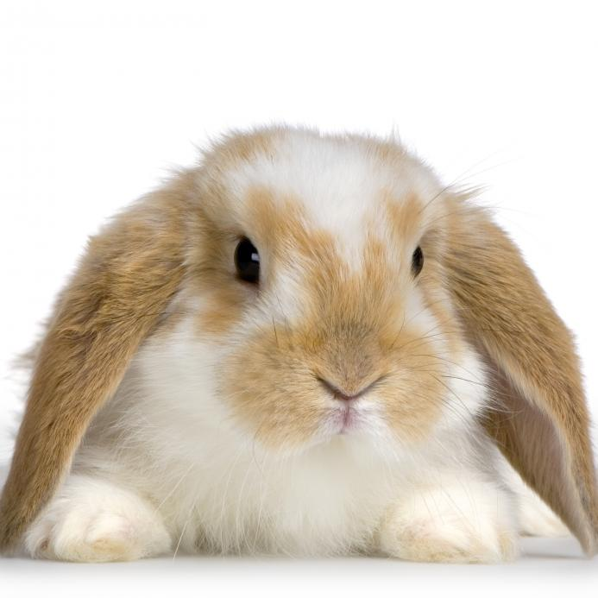
bunny
http://washhumane.typepad.com/.a/6a00e54eed855d8834017ee9cf65f4970d-pi

Slide 4
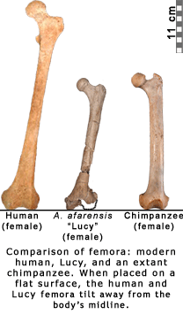
http://efossils.org/sites/efossils.org/files/BicondylarChimpLucy_0.gif

Slide 5
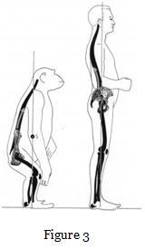
http://biologos.org/uploads/static-content/bipedality_fig_3.jpg

Slide 6
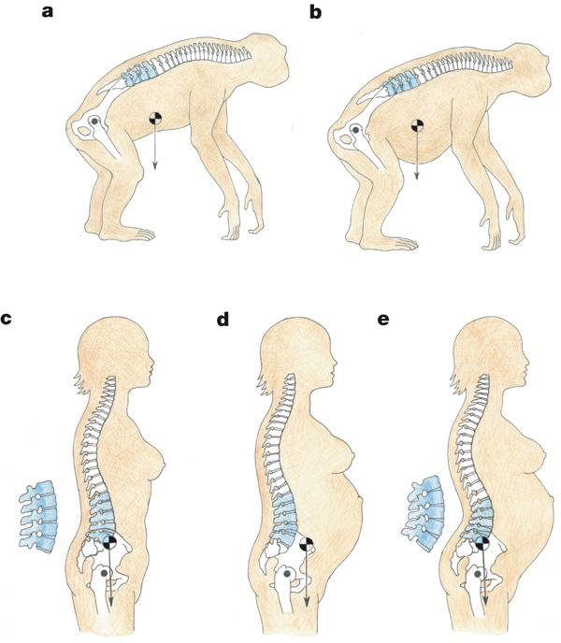
http://www.nature.com/nature/journal/v450/n7172/images/nature06342-f1.2.jpg

Slide 7
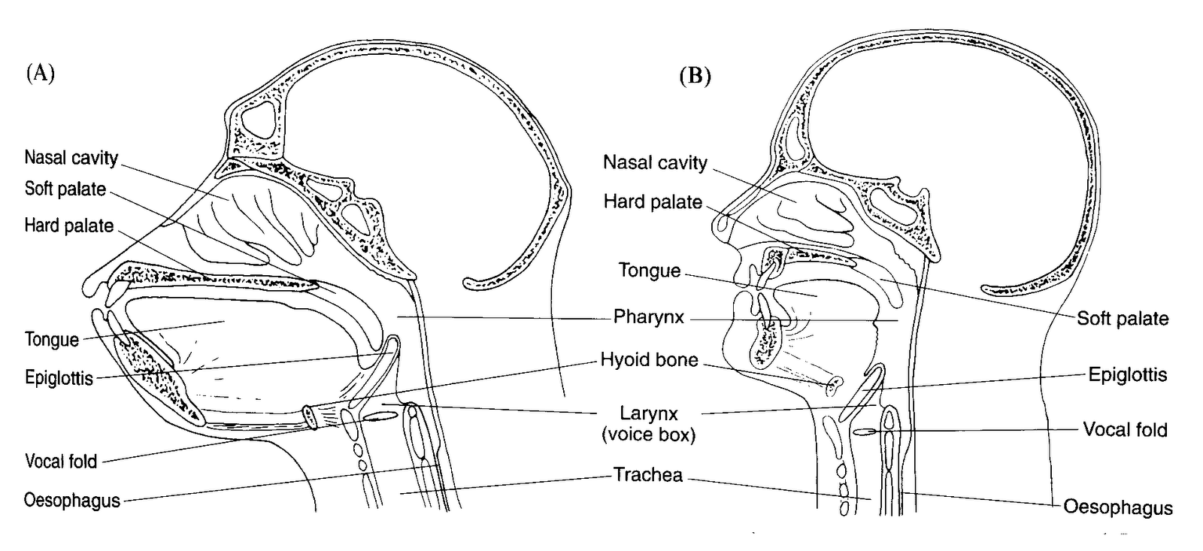
http://2.bp.blogspot.com/_rvOgdkttb5c/TKs5c9vFN4I/AAAAAAAAAPA/RJrVX4ZcHKQ/s1600/Vocal+Tracts.gif

Slide 8
http://crankylinguist.blogspot.com/2010/10/chimp-vs-human-vocal-tracts.html
Essentially, in apes the larynx is higher and the epiglottis can lock with the velum; in humans the larynx is too low for this to happen. Also, ape tongue movement is mostly in-out, while humans can move the muscle up and down as well as in-out. Furthermore, the tube through which air passes from the glottis out to the lips is gently curved in apes, but in humans it forms a right angle. Anyone who plays any kind of wind instrument knows that different shapes produce different sounds.
What all this means is that apes (and human newborns, who are similar) cannot produce sounds with the acoustic properties of adult human speech. And it's why it was such a stroke of genius to try out manually-produced sign languages on them.

Slide 9
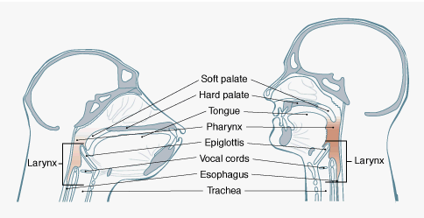
http://pubpages.unh.edu/~jel/images/vocal_tract_chimp.gif

Slide 10
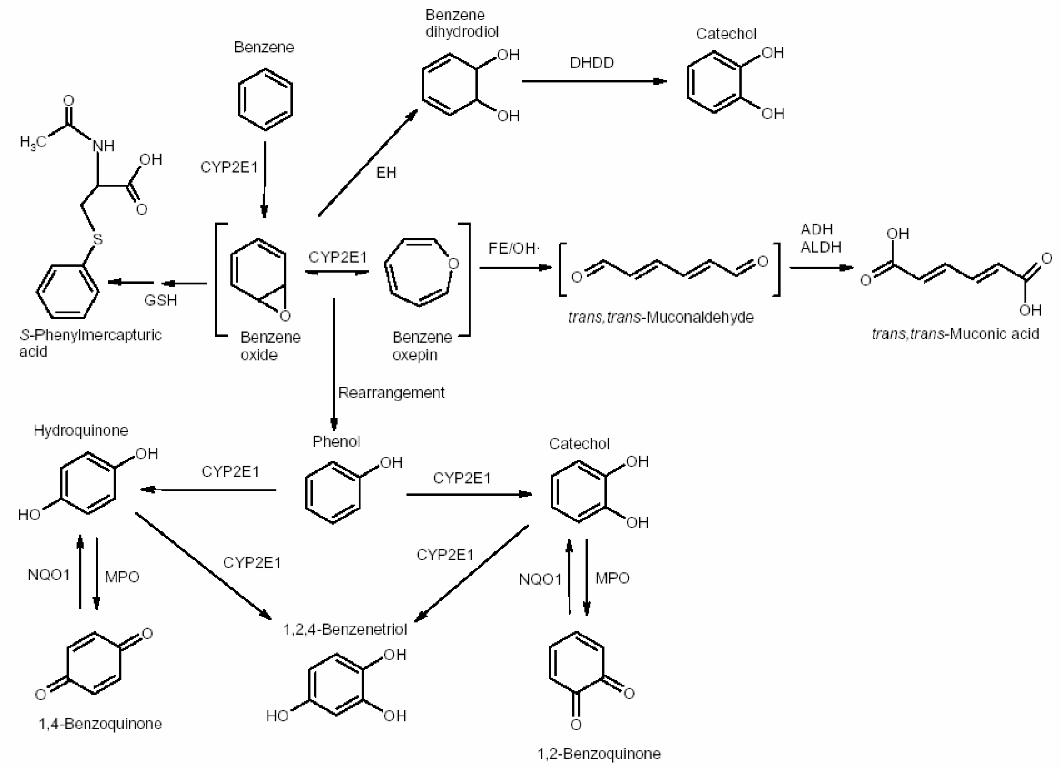
http://www.grin.com/object/external_document.258079/56056a2a33e8cd8c5277da4222089cb8_LARGE.png

Slide 11
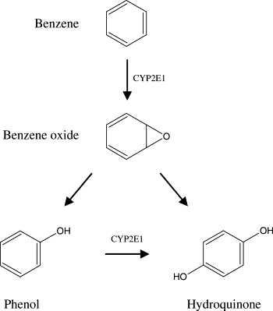
http://ars.els-cdn.com/content/image/1-s2.0-S138266890400167X-gr3.gif

Slide 12
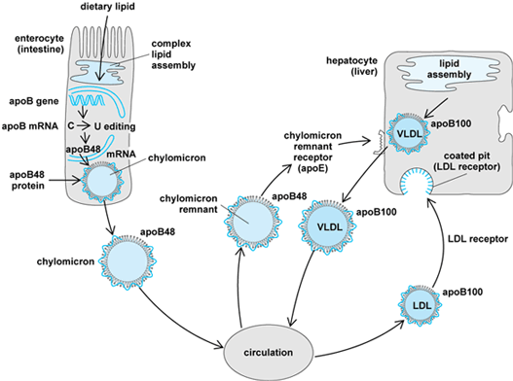
http://www.accessscience.com/loadBinary.aspx?aID=6683&filename=YB030225FG0010.gif

Slide 13
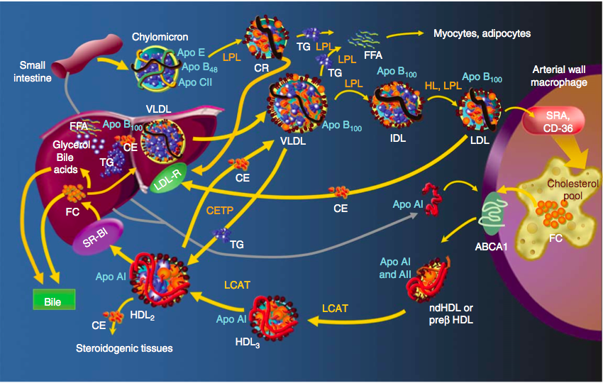
http://cardiologydoc.files.wordpress.com/2012/05/the-whole-story.png

Slide 14
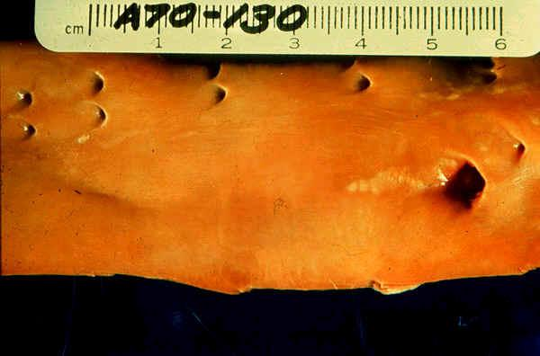
http://www.anesthesia2000.com/Cardio/Cardio_risk/fatty_streaks1.jpg

Slide 15
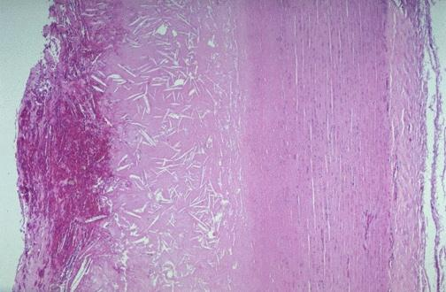
http://library.med.utah.edu/WebPath/jpeg5/CV014.jpg

Slide 16
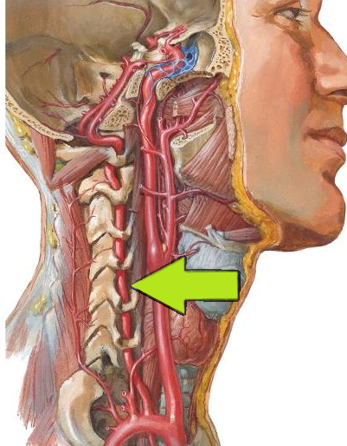
http://classconnection.s3.amazonaws.com/930/flashcards/619930/png/vertebral_artery1312142110634.png

Slide 17
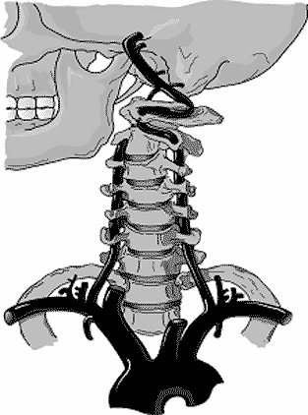
http://www.imaging.robarts.ca/SPARC/sites/default/files/neck.gif

Slide 18
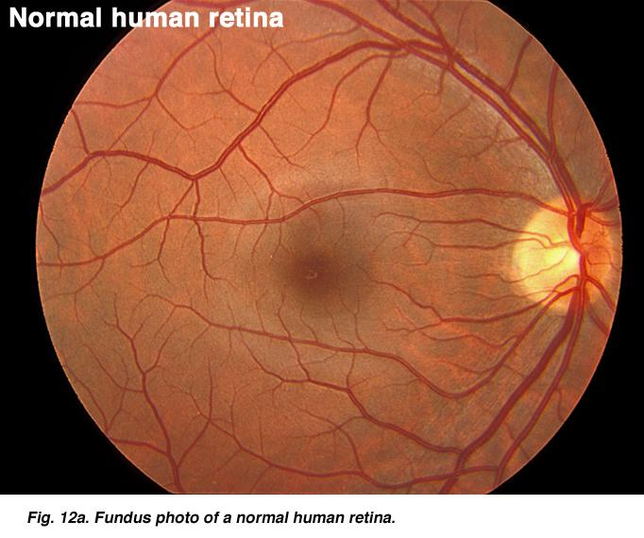
http://webvision.med.utah.edu/imageswv/DONFig12a.jpg

Slide 19
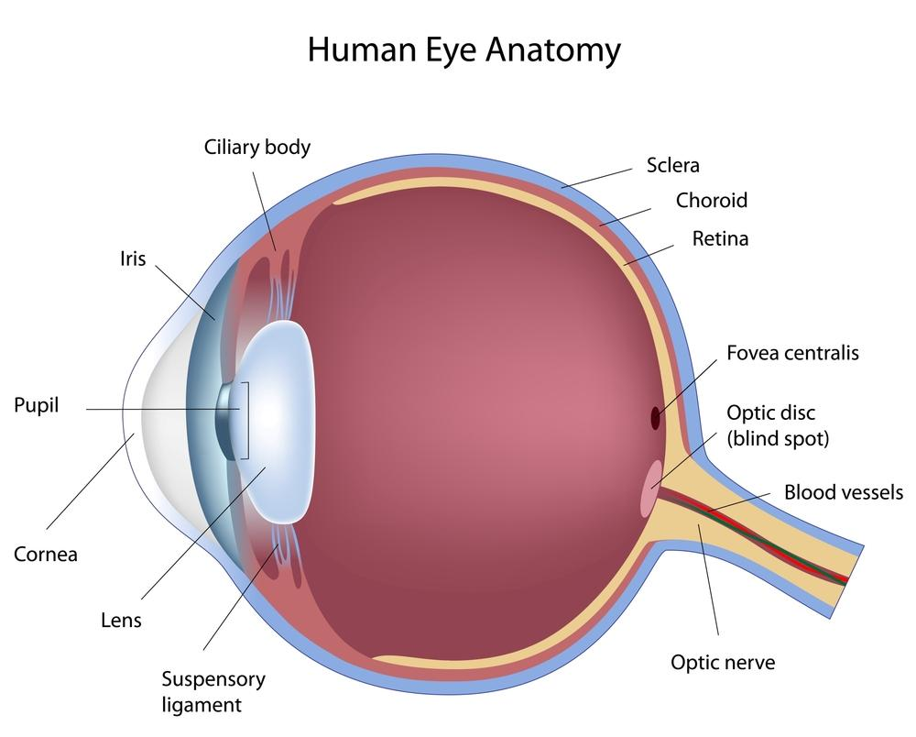
http://www.garetina.com/img/eye-diagram.jpg

Slide 20
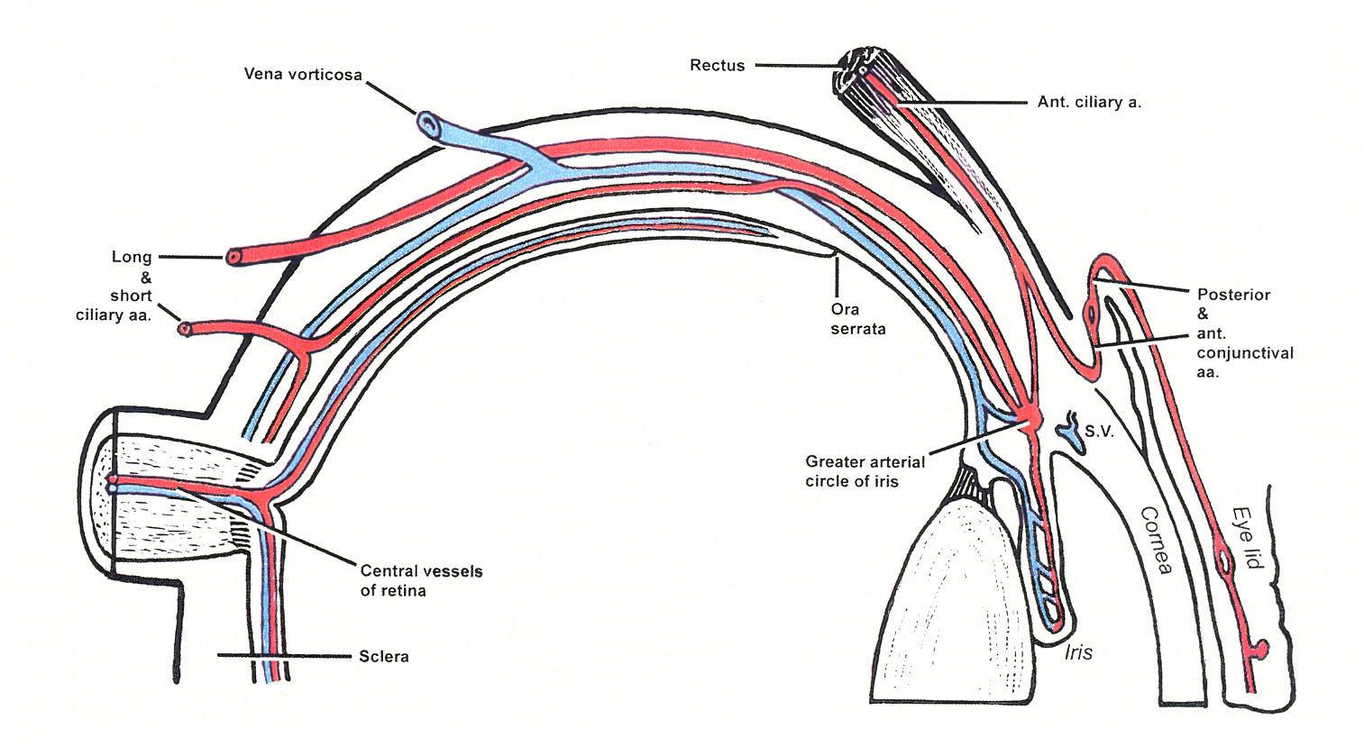
http://www.dartmouth.edu/~humananatomy/figures/chapter_46/46-10_files/IMAGE001.JPG

Slide 21
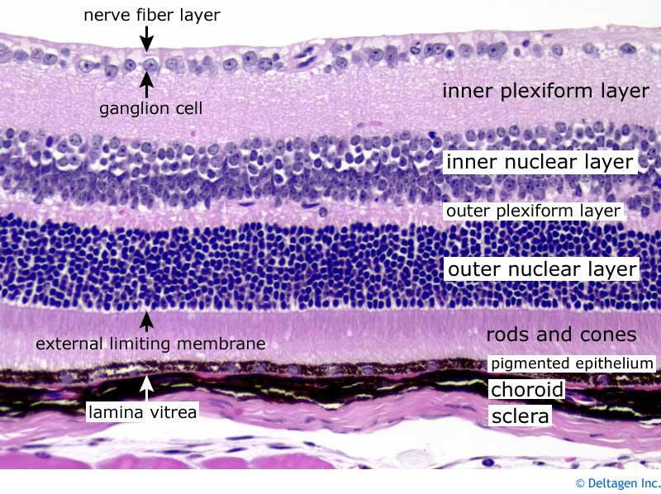
http://apbrwww5.apsu.edu/thompsonj/Anatomy%20&%20Physiology/2010/2010%20Exam%20Reviews/Exam%204%20Review/retina_layers.jpg

Slide 22
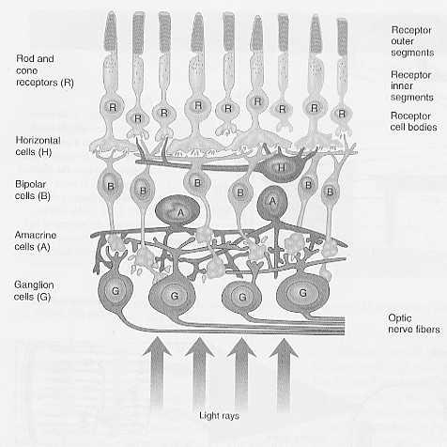
http://facweb.cs.depaul.edu/sgrais/images/ColorBlind/RetinaLayers.jpg

Slide 23
Cushing reflex
Intracranial pressure leads to compression of arterioles and dimished blood flow.
Sympathetic nervous system increases vascular resistence. BP goes up. ICP goes up.
Carotid baroreceptors signal parasympathetic to slow heart rate to compensate

Slide 24
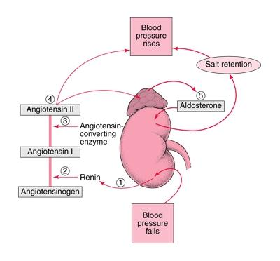
Renal Bp
http://24.media.tumblr.com/tumblr_lkc4u6Ufnw1qcmrkno1_400.jpg

Slide 25
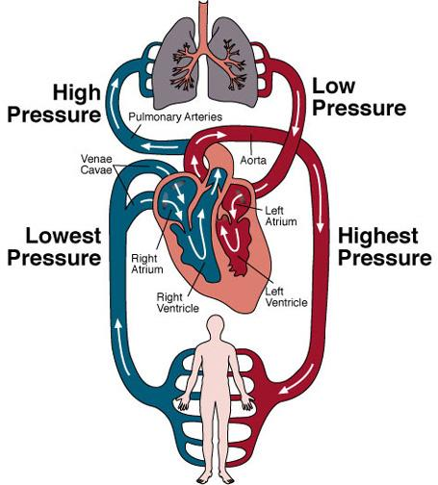
http://images.emedicinehealth.com/images/4453/4453-4478-10929-25123.jpg

Slide 26
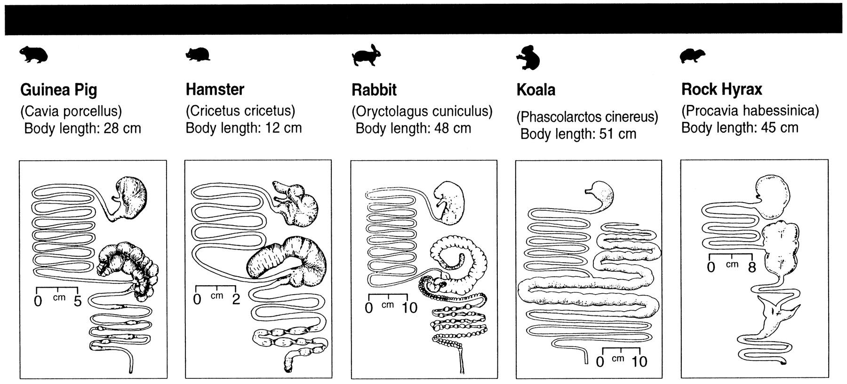
http://physrev.physiology.org/content/78/2/393/F6.large.jpg

Slide 27
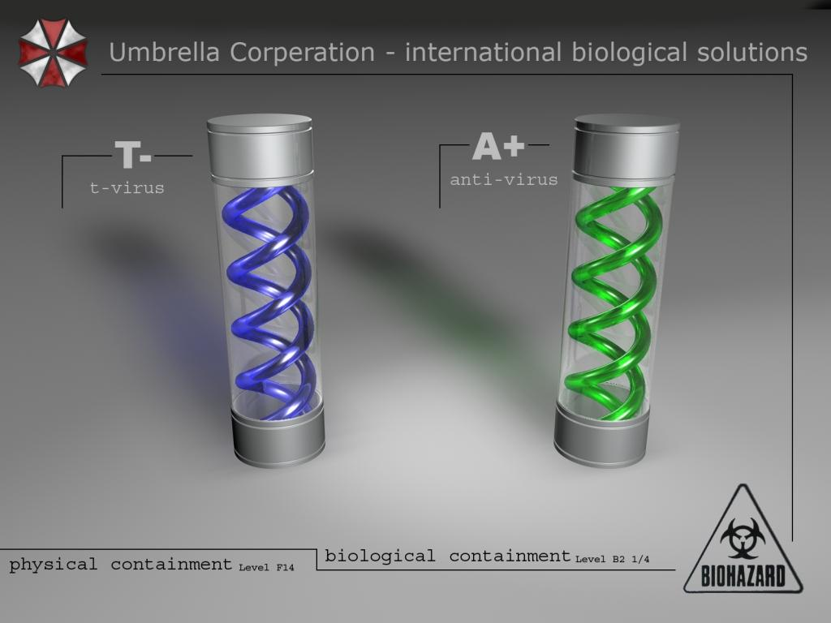
Why the Zombie apocalypse won't happen
1. There is not enough room for that much awesome.
2. Disease is about the human immune response, not the germ.

Slide 28
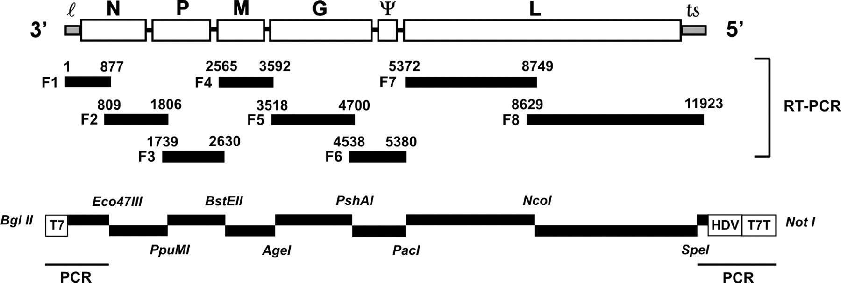
rabies genome
http://www.pnas.org/content/101/46/16328/F1.large.jpg

Slide 29
Adenovirus FAQs
What is adenovirus?
Adenoviruses were first isolated in human adenoids, from which the name is derived. Adenoviruses are medium-sized (90–100 nm), nonenveloped (naked) icosahedral viruses composed of a nucleocapsid and linear, non-segmented double stranded (ds) DNA genome which is about 36kb long.
Recombinant adenovirus vector usually delete E1 and E3 genes from genome of wild type adenovirus, making it replication deficiency so it can be safely used as transgene vector. E1 plus E3 are about 8.0 kb so the maximum insert size of your interesting gene is about 8.0kb, taking it into account that Promoter and Poly A occupy about 1 kb, so the maximum insert size is about 7 kb.

Slide 30
http://www.invitrogen.com/site/us/en/home/References/protocols/proteins-expression-isolation-and-analysis/protein-expression-protocol/lentiviral-expression-systems.html
ViraPower™ Lentiviral Expression Systems
The size of your gene of interest. Titers will decrease as the size of the insert increases. We have determined that virus titer drops approximately 2-fold for each kb over 4 kb of insert size. If you wish to produce lentivirus with an insert of >4 kb, you will need to concentrate the virus to obtain a suitable titer. The size of the wild-type HIV genome is approximately 10 kb. Since the size of the elements required for expression from pLenti vectors total approximately 4-4.4 kb, the size of your insert should not exceed 5.6 kb.

Slide 31
http://www.merckvetmanual.com/mvm/index.jsp?cfile=htm/bc/102300.htm
Furious Form:
This is the classic “mad-dog syndrome,” although it may be seen in all species. There is rarely evidence of paralysis during this stage. The animal becomes irritable and, with the slightest provocation, may viciously and aggressively use its teeth, claws, horns, or hooves. The posture and expression is one of alertness and anxiety, with pupils dilated. Noise invites attack. Such animals lose caution and fear of other animals. Carnivores with this form of rabies frequently roam extensively, attacking other animals, including people, and any moving object. They commonly swallow foreign objects, eg, feces, straw, sticks, and stones. Rabid dogs may chew the wire and frame of their cages, breaking their teeth, and will follow a hand moved in front of the cage, attempting to bite. Young pups can seek human companionship and are overly playful, but bite even when petted, usually becoming vicious in a few hours. Rabid skunks may seek out and attack litters of puppies or kittens. Rabid domestic cats and bobcats can attack suddenly, biting and scratching viciously. As the disease progresses, muscular incoordination and seizures are common. Death results from progressive paralysis.

Slide 32
http://www.merckvetmanual.com/mvm/index.jsp?cfile=htm/bc/102300.htm
Paralytic Form:
This is first manifest by paralysis of the throat and masseter muscles, often with profuse salivation and inability to swallow. Dropping of the lower jaw is common in dogs. Owners frequently examine the mouth of dogs and livestock searching for a foreign body or administer medication with their bare hands, thereby exposing themselves to rabies. These animals may not be vicious and rarely attempt to bite. The paralysis progresses rapidly to all parts of the body, and coma and death follow in a few hours.
Species Variations:
Cattle with furious rabies can be dangerous, attacking and pursuing humans and other animals. Lactation ceases abruptly in dairy cattle. The usual placid expression is replaced by one of alertness. The eyes and ears follow sounds and movement. A common clinical sign is a characteristic abnormal bellowing, which may continue intermittently until shortly before death.

Slide 33
http://www.merckvetmanual.com/mvm/index.jsp?cfile=htm/bc/102300.htm
Horses and mules frequently show evidence of distress and extreme agitation. These signs, especially when accompanied by rolling, may be interpreted as evidence of colic. As in other species, horses may bite or strike viciously and, because of their size and strength, become unmanageable in a few hours. People have been killed outright by such animals. These animals frequently suffer self-inflicted wounds.
Rabid foxes and coyotes often invade yards or even houses, attacking dogs and people. The abnormal behavior that can occur is demonstrated by the fox that attacks a porcupine; finding a fox with porcupine quills can, in most cases, support a diagnosis of rabies.

Slide 34
http://www.merckvetmanual.com/mvm/index.jsp?cfile=htm/bc/102300.htm
In general, rabies should be suspected in terrestrial wildlife acting abnormally. The same is true of bats that can be seen flying in the daytime, resting on the ground, attacking people or other animals, or fighting.
Rodents and lagomorphs rarely constitute a risk for rabies exposure. However, each incident must be evaluated individually. Reports of laboratory-confirmed rabies in woodchucks are not uncommon in association with the raccoon rabies epizootic in the eastern USA.

Slide 35
Why the Zombie apocalypse won't happen
1. There is not enough room for that much awesome inside a virus. 4-10 kilobases
2. Disease is about the human immune response, not the germ.
3. Its hard to be lethal and
contagious

Slide 36
Pathogens are fastidious guests:
eg.Streptococcus, Staphylococcus, Neisseria require blood agar
Thermus Thermophilus (Taq polymerase) grows very slow below 60oC
Carnobacterium grow where people cannot (Mars, tundra)
Lethal cooties are hard to get. contagious cooties are rarely lethal or grow very slowly (TB)
TB & mycobacteria

Slide 37
Splash for us 2013

